Slide 1
Elastic Database, going to the infinity *
Emanuele Zanchettin
@_thinkIT_
thinkit.it – ezanchettin@thinkit.it

Slide 2











Sponsors

Slide 3





Organizers
getlatestversion.it

Slide 4
Agenda
Scalability
Service evolution
Elastic scale
Prices
Performance sharing
Elastic database pool
Have fun with Elastic Scale & pool

Slide 5






Speaker | Emanuele Zanchettin
15+ years of experience
data architect and consultant about SQLServer and Azure SQL Database
analyst and software developer using .NET
coordinator of resources and IT projects
Community Lead at 1nn0va – an Official Microsoft Community
Speaker about SQLServer and Azure SQL Database technologies
CEO and co-founder thinkIT ISO 9001:2008 (Quality) ISO/IEC 20000-1:2011 (IT Services)
ezanchettin@thinkit.it – http://www.thinkit.it/

Slide 6
About you
Have you had a light lunch, sleeping time .. ???
Are you awake? ☺
Try to raise your hand
Try to clap your hands
How many people are using … (raise your hand)
SQL Server?
Azure SQL Database?
SS Management Studio?
MS Visual Studio?

Slide 7

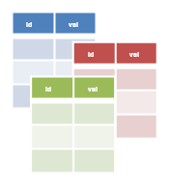

Data partitioning - Scalability
Database
Id | val
Id | val
Id | val
Scale-up
Vertical
Partitioning
Scale-out
Horizontal partitioning
bigger db
more dbs
Elastic scale (ex. app multi-tenant)

Slide 8
Conclusions
Scale-up
All right ☺
Vertical Partitioning
External foreign keys, between databases, not permitted
You can not have transactions between databases
Even using Microsoft Distributed Transaction Coordinator ☹
Scale-out or horizontal partitioning
Embedded in Azure ☺
Schema design 😐
Developing and troubleshooting are little bit hard ☹
Elastic Scale ☺ … was Federation …
Scale in-out / up-down .. ☺☺☺

Slide 9
The choice, conscious
 | Basic | Standard |  |  |  | Premium
 |  | S0 | S1 | S2 | S3 | P1 | P2 | P4 | P6/P3 | P11 | P15
Max DTUs | 5 | 10 | 20 | 50 | 100 | 125 | 250 | 500 | 1000 | 1750 | 4000
Max Database Size | 2 | 250 |  |  |  | 500 |  |  |  | 1000 | 1000
Max in-memory OLTP storage (GB) | N/A | N/A |  |  |  | 1 | 2 | 4 | 8 | 14 | 32
Max concurrent workers | 30 | 60 | 90 | 120 | 200 | 200 | 400 | 800 | 1600 | 2400 | 6400
Max concurrent logins | 30 | 60 | 90 | 120 | 200 | 200 | 400 | 800 | 1600 | 2400 | 6400
Max concurrent sessions | 300 | 600 | 900 | 1200 | 2400 | 2400 | 4800 | 9600 | 19200 | 32000 | 32000
Point-in-time-restore (any point last) | 7 days | 35 days |  |  |  | 35 days
Disaster recovery | Active Geo-Replication, up to 4 only (readable) secondary backups

Slide 10
The choice, conscious – other POV

Slide 11




Other conclusions
Service evolution
f(x)
tomorrow?
today
last year
some years ago
t
start

Slide 12
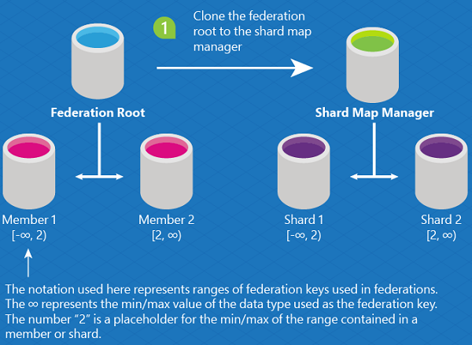
Evolution from Federation to Elastic Scale
The Azure SQL Database Federations feature is being retired along with the Web/Business editions in September 2015 (Cit.)

Slide 13
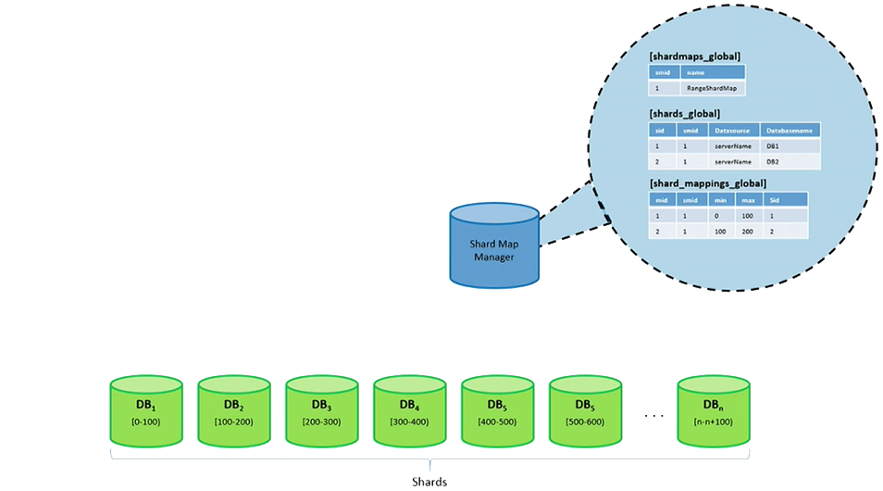

Shard Map
Two types of Shard Map
Range: intervals contiguous elements
List: list of values
Four types of keys
INT
BIGINT
GUID
VARBINARY

Slide 14
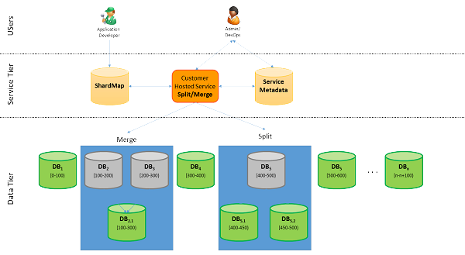
Split/Merge scenario
Some comands
CreateShard ☺
DeleteShard
CreateRangeMapping
CreatePointMapping
DeleteMapping
UpdateMapping
MarkMappingOffline
MarkMappingOnline
Key | Shard Location
1 | Database_A
3 | Database_B
4 | Database_C
6 | Database_B
... | ...
Key Range | Shard Location
[1, 50) | Database_A
[50, 100) | Database_B
[100, 200) | Database_C
[400, 600) | Database_C
... | ...

Slide 15
Easy to understand
Vertical: Scale-up or scale-down
Horizontal: Scale-out or scale-in
Premium
Premium
Standard
Standard
Scale up/down
Basic
Basic
Basic
Basic
Basic
Basic
Scale out/in

Slide 16
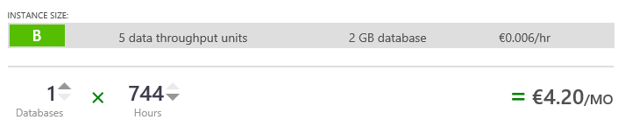
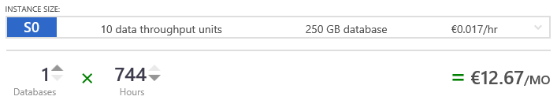
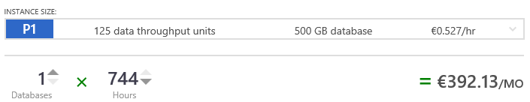
Price
How much “single database”

Slide 17
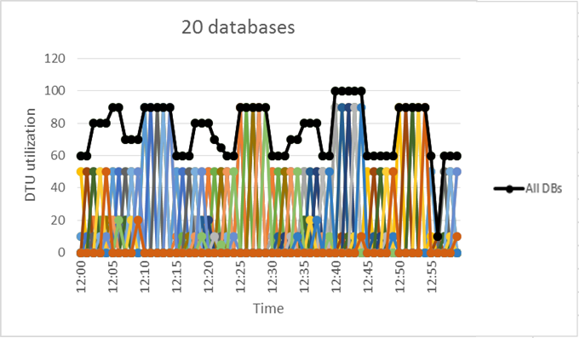
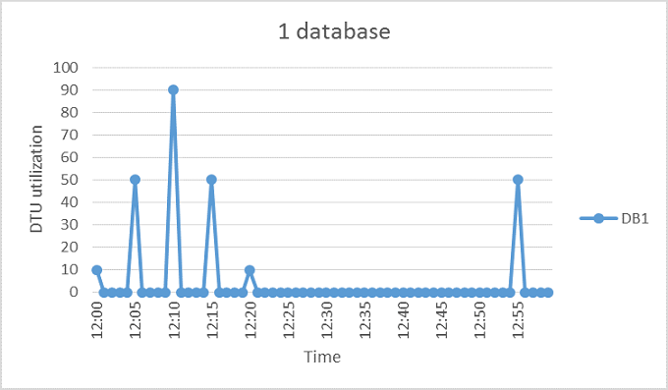
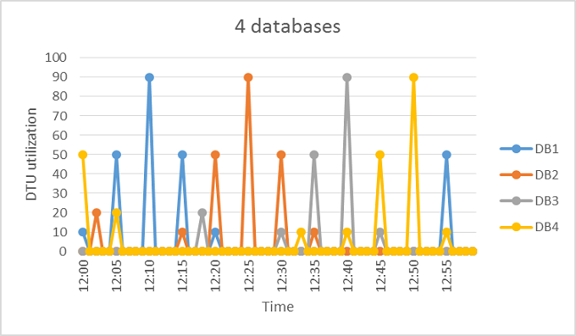
Next step
Performance sharing
Example 20 * S3 (100 DTU)
€ 2.529,60/mo
Example 4 * S3 (100 DTU)
€ 505,92/mo
Example 1 * S3 (100 DTU)
€ 126,48/mo

Slide 18
Elastic database pool
Generally available
Evolution of elastic database management
“Container” of eDTU
Resource Sharing
Predictable budget
Scalable
Not ideal for every scenarios 😐
Use it only if you need it ☺

Slide 19


In others words
Single
Shared

Slide 20
Easy to understand
Vertical: Scale-up or scale-down (DTU)
Horizontal: Scale-out or scale-in (db nums)
Elastic database pool
Scale DTU pool up/down
Scale db nums out/in

Slide 21
Price
How much “elastic database”

Slide 22
Comparison
Simple database
Elastic database
20 x S3 100DTU
Up to 2000DTU
Up to 5TB (250GB/each)
€ 2.529,80
1 X STD 100eDTU
Up to 100DTU
Up to 100GB (250GB/each)
€ 188,22
You SAVE
20x DTU
13x expense
LIMITS (MNU)

Slide 23
DEMO
Have fun with Elastic Scale & Elastic DB
ShardMap Manager (Application – SSMS)
Elastic Database Pool (Azure Portal)
Elastic Database Jobs (Azure Portal, if in time ☺)
Notes:
In questa semplice dimostrazione andremo ad utilizzare questo editor: http://codebeautify.org/xmltojson che consente di mettere a confronto velocemente i due formati.

Slide 24
Links
Azure SQL Database Elastic Scale Ch9 channel9.msdn.com/Shows/Data-Exposed/Azure-SQL-Database-Elastic-Scale
SQL Database Service Level Agreement (SLA)
azure.microsoft.com/it-it/support/legal/sla/
SQL Database pricing
azure.microsoft.com/en-gb/pricing/details/sql-database/
Guidelines and Limitations (Windows Azure SQL Database)
docs.microsoft.com/en-us/azure/sql-database/sql-database-general-limitations

Slide 25
Links
Elastic database pool for SQL databases
docs.microsoft.com/en-us/azure/sql-database/sql-database-elastic-pool
docs.microsoft.com/en-gb/azure/sql-database/sql-database-elastic-pool-guidance
docs.microsoft.com/en-us/azure/sql-database/sql-database-elastic-jobs-getting-started

Slide 26
Answer
depends on your ...
budget

Slide 27
Q&A
Questions?

Slide 28

Thanks!
#sqlsatParma
#sqlsat566

